Slide 1

Introduction to Machine Learning Operations (MLOPs)
Group - 4
B. Pranay Raj

Slide 2
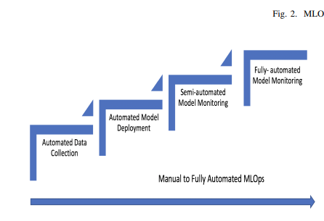
What is Machine Learning Operations (MLOps)?
MLOps, short for Machine Learning Operations, is a set of practices, processes, and tools that facilitate the seamless integration of machine learning (ML) models into the broader software development and operational workflows. MLOps aims to streamline and automate the end-to-end lifecycle of ML applications, from initial development and training to deployment, monitoring, and continuous improvement in real-world production environments. It involves collaboration between data scientists, machine learning engineers, developers, and IT operations to ensure the efficient and reliable deployment, management, and maintenance of ML models at scale.
STEPS OF MLOps
Automated Data Collection
Automated Model Deployment
Semi-automated Model Monitoring
Fully-Automated Model Monitoring

Slide 3
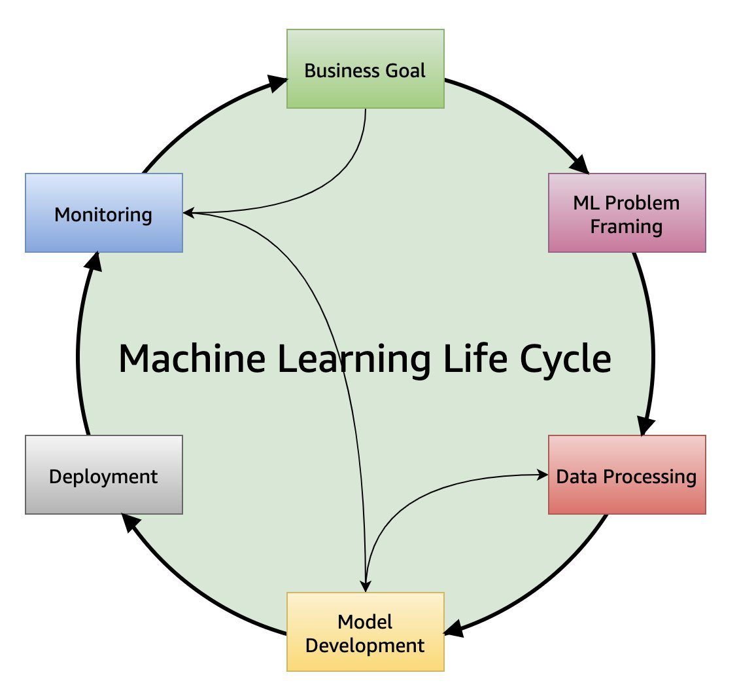
Overview of a Machine Learning Lifecycle
Business goal identification
Clearly define the problem you want to solve using machine learning.
Understand the business context and define the objectives of the ML project.
ML problem framing
Determining what to predict and how performance and error metrics must be optimized is a key step in this phase
Data processing (data collection, data preprocessing, feature engineering)
Clean and preprocess the data to make it suitable for training ML models.
Handle tasks like normalization, feature scaling, and encoding categorical variables.
Model development (training, tuning, evaluation)
Model development consists of model building, training, tuning, and evaluation. Model building includes creating a CI/CD pipeline that automates the build, train and release to staging and production environments.
Model deployment (inference, prediction)
After a model is trained, tuned, evaluated and validated, you can deploy the model into production. You can then make predictions and inferences against the model.
Model monitoring
Implement monitoring systems to track the model's performance in real-world conditions.
Regularly update and retrain the model to adapt to changes in the underlying data distribution.

Slide 4
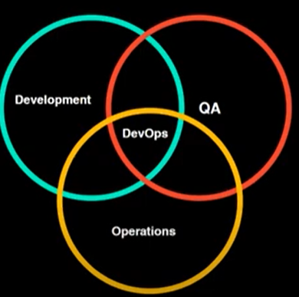
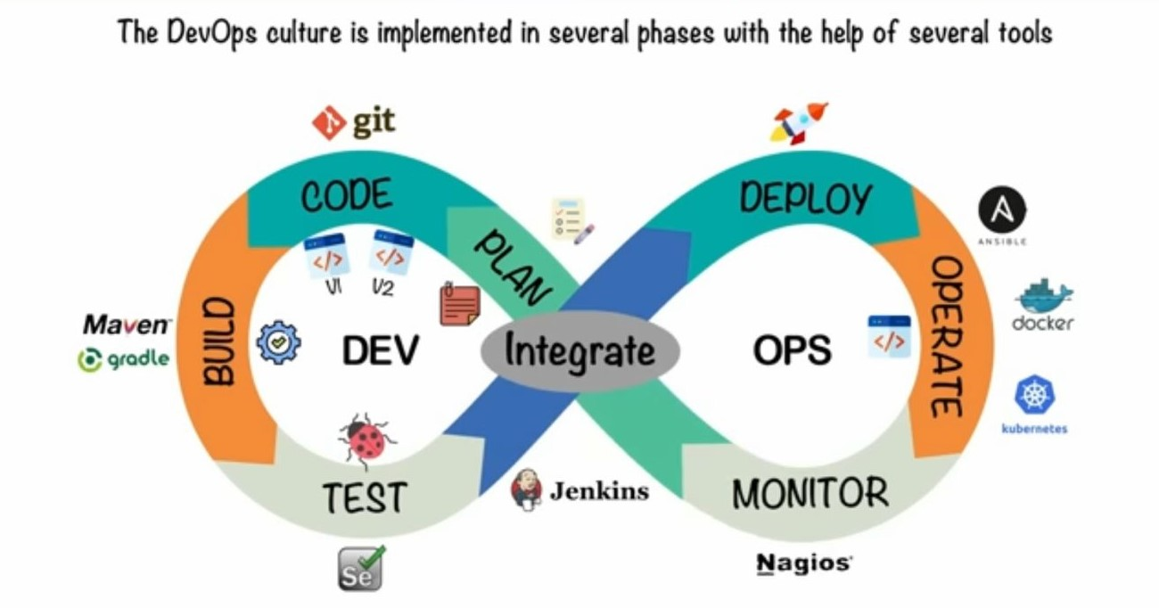
What is DevOps? DevOps is a set of practices that combines software development (Dev) and IT operations (Ops). It aims to shorten the systems development life cycle and provide continuous delivery with high software quality. That combines multiple team to co-ordinate & collaborate to produce better and reliable products.
Can add Diagram of DevOps lifecycle
Explanation
Collaboration: DevOps promotes collaboration between development and operation teams, fostering a culture of shared responsibility and accountability.
Automation: It emphasizes automation of processes, minimizing manual interventions that can lead to errors and inefficiencies.
Continuous Integration: DevOps enables continuous integration to ensure that code changes are frequently and consistently built, tested, and deployed.
Purpose
Efficiency: The primary purpose of DevOps is to improve efficiency in development, testing, and deployment processes.
Quality: It aims to enhance software quality by accelerating feedback loops, ensuring robust testing, and frequent delivery of updates in the market demands and within the company also.
Relevance to MLOps
Data Security: DevOps practices are relevant to MLOps as they ensure secure and compliant handling of sensitive data in machine learning operations.
Version Control: Effective version control and code management are essential in both DevOps and MLOps to maintain consistency and transparency.

Slide 5
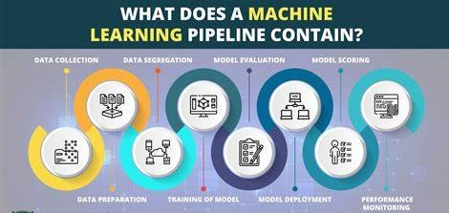
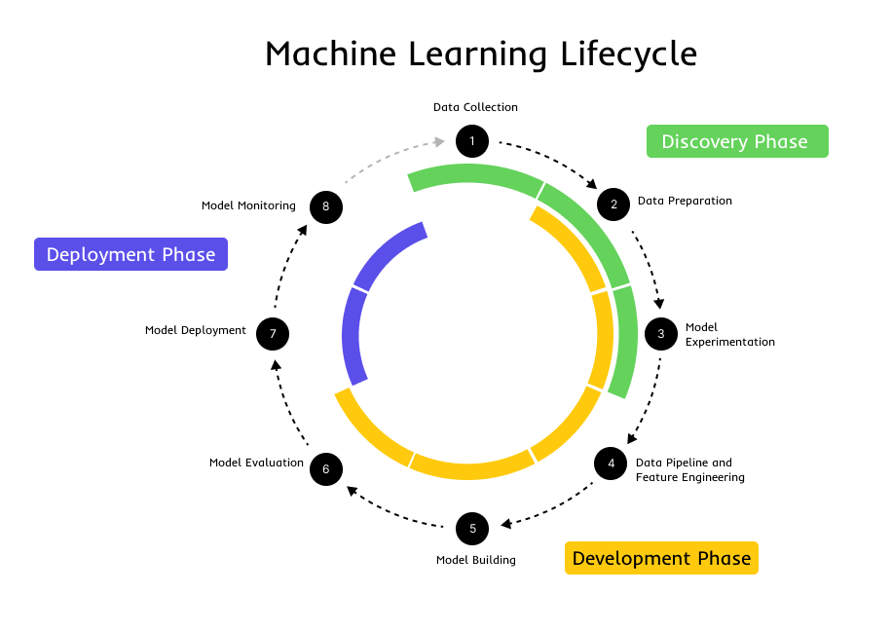
Typical MLOps Pipeline MLOps, is a method of collaboration and communication between data scientists and operations specialists. It covers the complete process of model development and deployment.
Lifecycle of a MLOps pipeline
With the use of Pipeline it has better readability, easy to debug and an automated process.
Development
During this phase, data scientists work on model training, validation, and testing.
Deployment
After development, the model moves to the deployment phase for integration with systems and applications.
Monitoring
Once deployed, the model is continuously monitored for performance and quality.

Slide 6
Recommendations
A startup company wishing to incorporate machine learning models into its production platform should take a basic and realistic approach. Start small, test properly, learn from feedback, and progressively expand to more complicated systems as your confidence and expertise improve. This manner, they can reduce risk and lay a solid platform for future growth.
In industries such as automotive, machine learning (ML) can bring significant value to a product and be a game changer for innovation.
To improve in predict demand, and manage inventory. It reduces expenses and increases customer satisfaction by guaranteeing that products are in stock and delivered quickly.
To assist with complex decision-making processes in areas like healthcare, where the stakes are high, and accuracy is critical.
To Implement ML for real-time anomaly detection to safeguard both the organization and its consumers from fraud, resulting in significant cost savings and brand trust from fraud detection.
Embed ML into business workflows to automate complex analytical tasks, which can help clients increase efficiency and make more informed decisions quickly.
Incorporate machine learning (ML) into analytics systems to streamline the process from data preparation to insight creation, hence making sophisticated analytics more accessible to non-tech users.

Slide 7

Thank You for Listening

